Slide 1
ONLINE SHOE SHOP

Slide 2
INTRODUCTION
This project is a web based shopping system for an existing shop. The project goal is to deliver the online shopping website using java.Online shopping is the process whereby consumers directly buy goods or services from a seller in real-time, without an a service, over the internet. It is a form of electronic commerce. This project is an attempt to provide the advantages of online shopping to customers of a real shop.It helps buying the shoes in the shop anywhere through internet by using this. Thus the customer will get the service of online shopping and home delivery.

Slide 3
OBJECTIVES
E-Commerce is a web-based application running on the localhost tomcat server. It covers all the functionality of an online shopping web application.
Where a user can view the required product and buy them. Users can search or filter the product according to the requirement. The admin is also an important role in the application. Admin can add the new product in the database and can track the record of all the products and transactions.
The main objective of the e-commerce project in java is to provide an online platform to sell their product.

Slide 4
BACKGROUND
The central concept of the application is to allow the customer to shop virtually using the internet and allow customers to buy the shoes from the shop. The information pertaining to the products are stores on database.

Slide 5
View of urban gear website

Slide 6
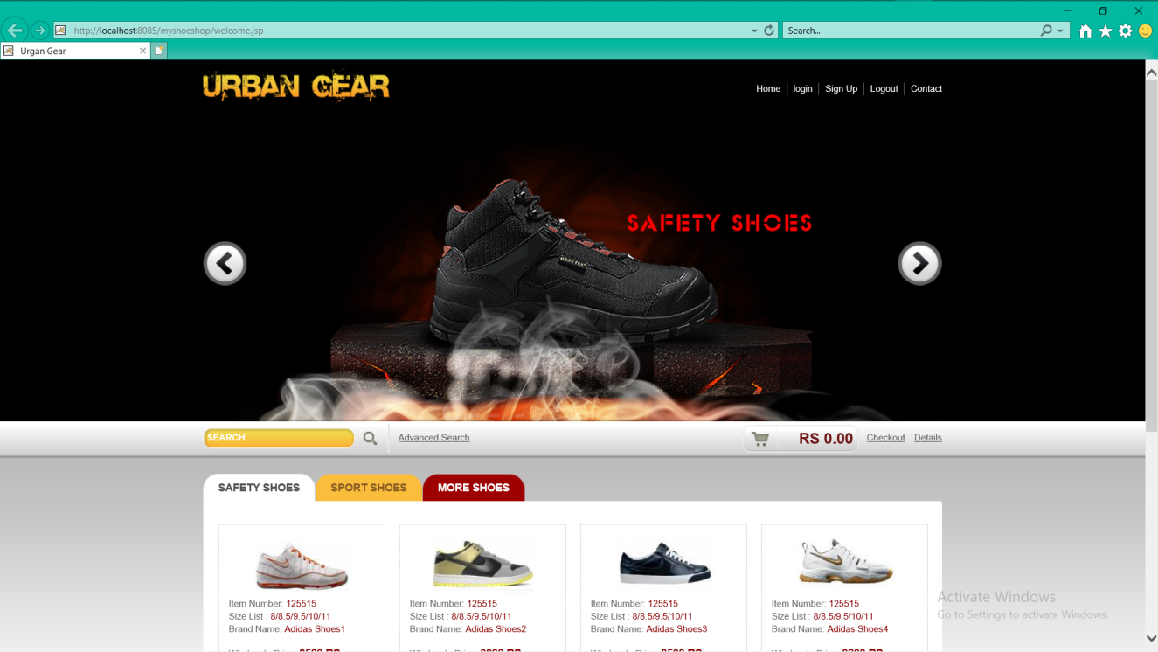
HOME PAGE

Slide 7
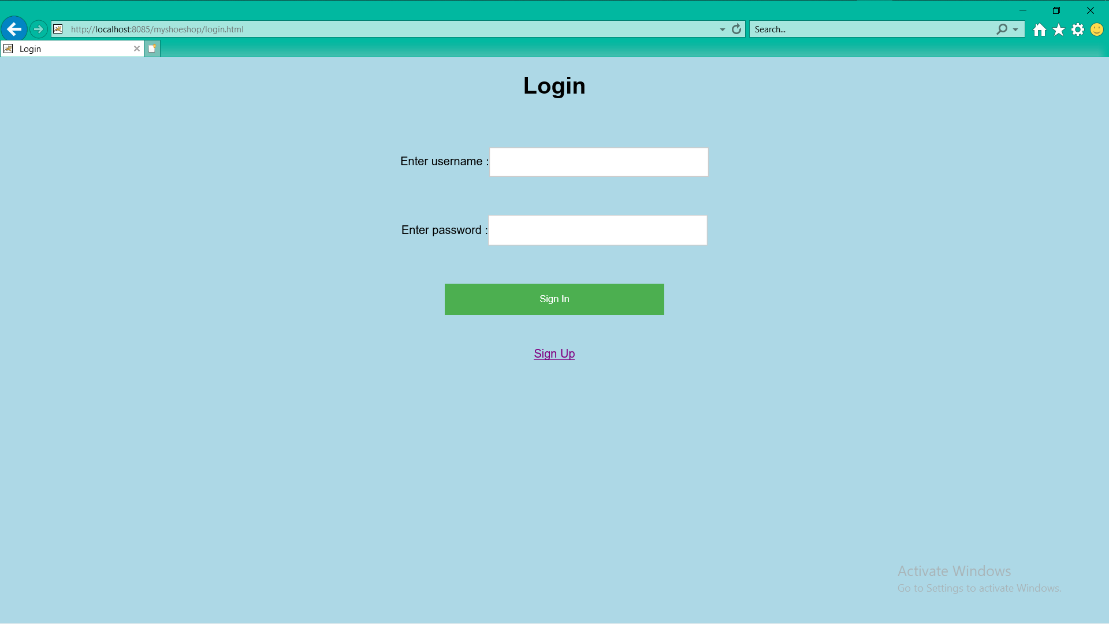
LOGIN PAGE

Slide 8
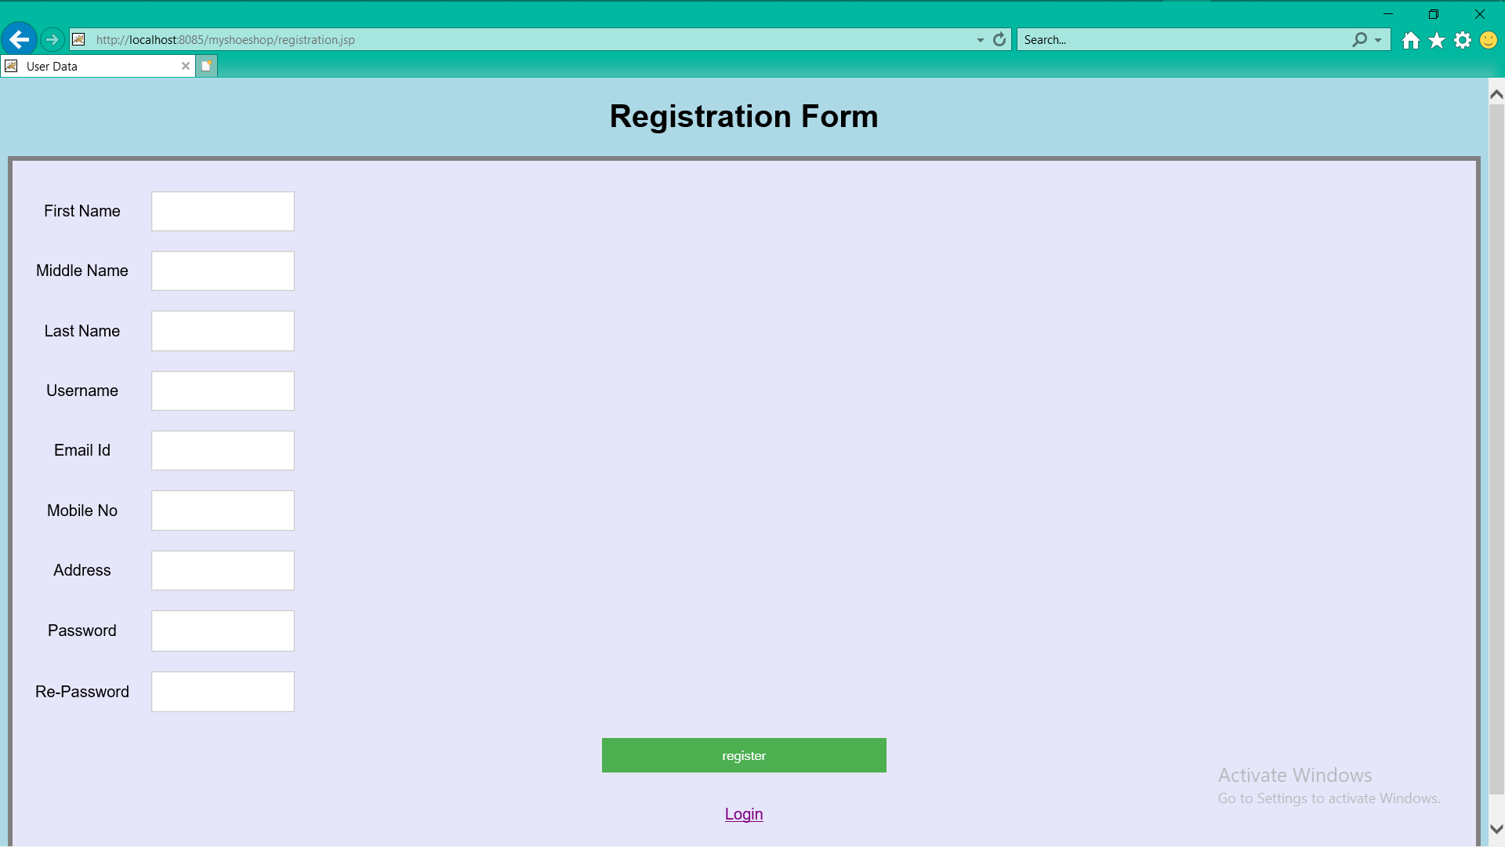
REGISTRATION PAGE

Slide 9
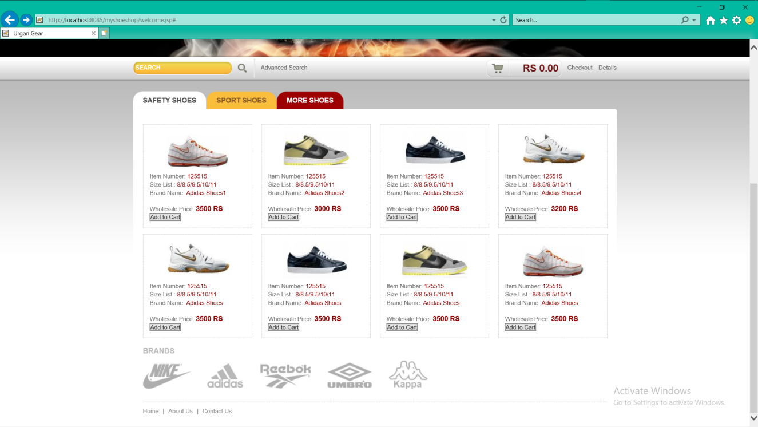
CATEGORY PAGE

Slide 10
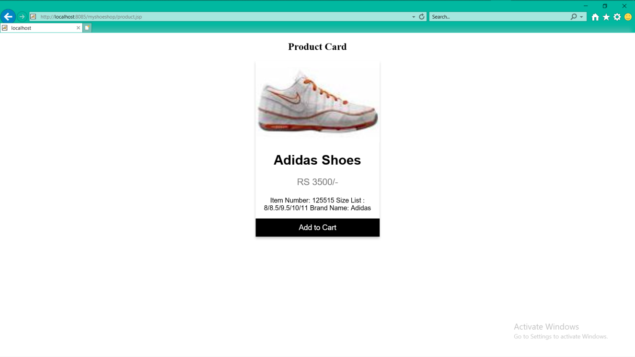
CART PAGE

Slide 11
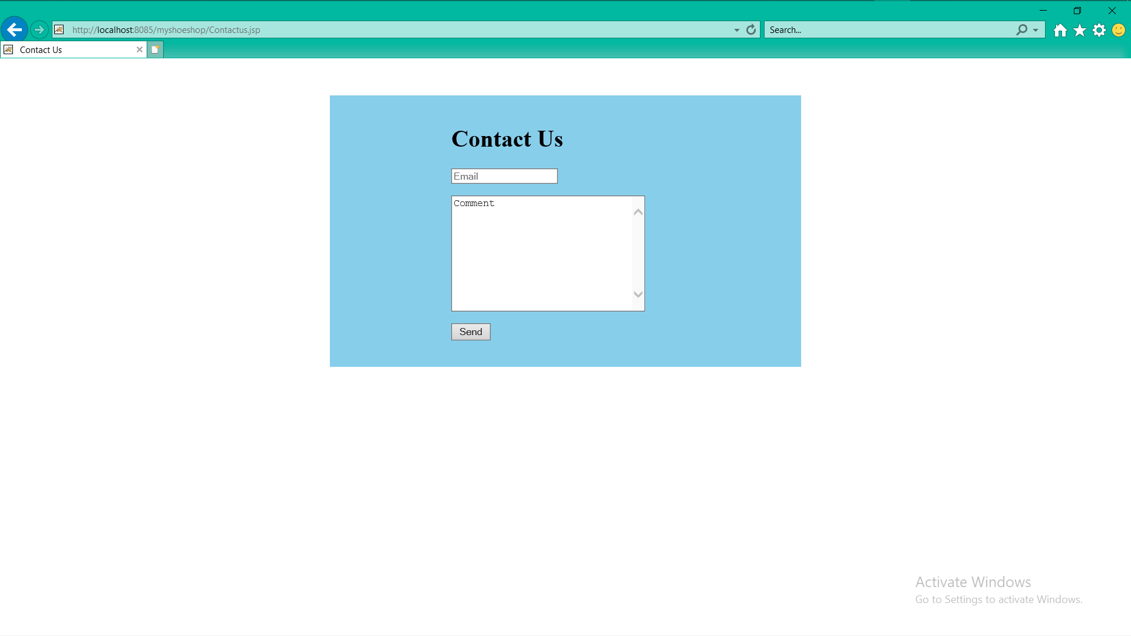
CONTACT US PAGE

Slide 12
CONCLUSION
Our project is only a humble venture to satisfy the needs to manage their project work. Several user friendly coding have also adopted.
This package shall prove to be a powerful in satisfying all the requirements of the customer. The objective of software planning is to provide a frame work that enables the manager to make reasonable estimates made within a limited time frame at the beginning of the software project and should be updated regularly as the project progresses.

Slide 13
REFERENCES
[1] Sam’s Teach Yourself Web Publishing with HTML and java code
[2] Learning MySQL, JavaScript, CSS & HTML5, by Robin Nixon, O’Reilly
publications.
[3]www.google.com
[4] www.Tutorialspoint.com

Slide 14
THANK YOU

